Slide 1
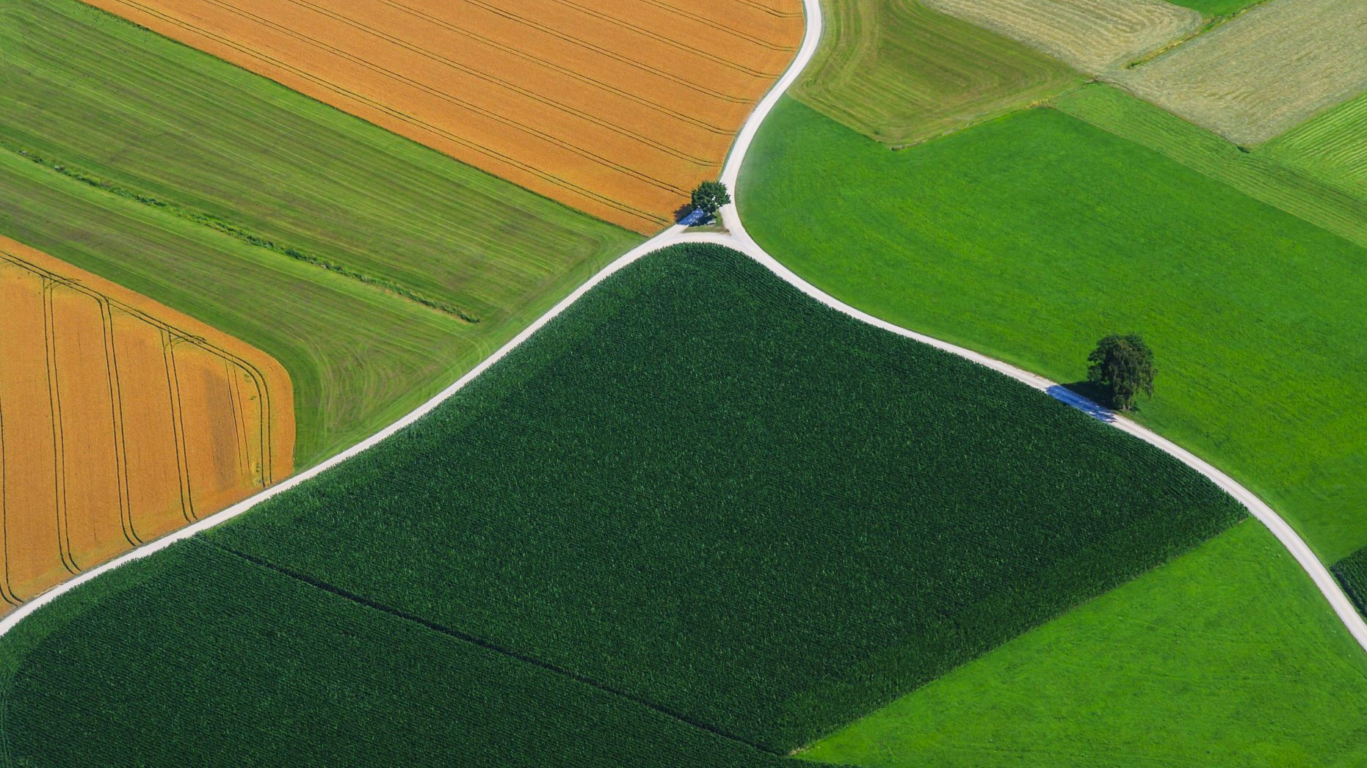
Configuring an Open-Source AI Model for Real-World Farm Analytics
By: Yahya Habib
Supervisors: Hassan Jaleel, Abubakr Muhammad

Slide 2
Problem Statement
Agriculture in Pakistan faces critical challenges such as
Water scarcity
Inefficient resource utilization
Yield variability
Higher Costs
Less Revenue

Slide 3
Research Objective
Build a Sustainable framework that Allows Farmers to:
Make Meaningful Decisions
Adopt to Sustainable practices
Maximize yield
Leverage the use of AI to act Proactively utilize farming efficiently

Slide 4
Proposed Tools
Tool / Goal | Human Input | IoT Input | Drone Image Support | AI-based Analytics | Customization | Free | Scalability | Support | URL | Pricing
FarmOS | 5 | 2 | 1 | 2 | 4 | 5 | 3 | 3 | farmos.org | Free
Azure Data Manager for Agriculture | 5 | 5 | 5 | 5 | 4 | 1 | 5 | 5 | Microsoft.com | GBP 625 per unit per day
GeoPard Agriculture | 4 | 2 | 5 | 3 | 3 | 2 | 4 | 4 | Geopard.tech | N/A
Botlink | 3 | 1 | 5 | 2 | 2 | 2 | 3 | 4 | botlink.com | $120 per month/ $1,200 per year
Farmonaut | 4 | 4 | 3 | 4 | 3 | 3 | 5 | 4 | farmonaut.com | $8 to $25 per acre
OneSoil | 4 | 2 | 2 | 4 | 2 | 4 | 5 | 3 | onesoil.ai
Granular | 5 | 4 | 2 | 4 | 3 | 2 | 5 | 5 | corteva.us
Farmvibes.ai | 1-2 | 4-5 | 5 |  |  |  | 5 | 5 |  | Free
Legend: 1 (Low), 2 (Somewhat Low), 3 (Moderate),4 (Somewhat High) ,5 (High) Note: Higher is better

Slide 5
Selection Criteria
Human Input
IoT Input
AI Analytics
Drone Image Support

Slide 6
Proposed Solution
FarmOS + FarmVibes.ai + Thingsboard CE (All Open Source, Scalable and Fulfils criteria Above, Strong Community Support)
Django + MinIO + PostgreSQL + PostGIS + GeoAI + Thingsboard CE

Slide 7
Expected Outcomes
Real time Data feed
Data correction
Real time AI Analytics for Precision Farming
Minimal Human Involvement

